Slide 1

Clustering Chicago’s Community Areas

Slide 2
Introduction
Chicago is often listed as the food capital of the US and many businesses are looking to scale up or open in Chicago
Clustering the 77 Community Areas of Chicago based on Venue Types.
Segmenting the Community Areas based on Population Density

Slide 3
How to Use The Models
Scale Ups
If a business is successful in a certain area of Chicago then they can use this clustering to pinpoint similar areas and to identify community areas in which they can project equal success.
New Businesses
A business can look at a community area where their competitors are performing well and based on this mapping they can select a similar community area for the location of their new venue. By doing so they can pick an area where they can expect success while also avoiding getting into direct competition with their competitors.

Slide 4
Data
Web Scraping will be performed on the Wikipedia page about the “Community areas in Chicago”, to retrieve the names of the Community areas and their respective population densities.
Foursquare Location Data will be used to retrieve the top venues in each of the different community areas of Chicago.
The Python Geocoding Library will be used to retrieve the coordinates of the different community areas in Chicago.

Slide 5
Data Acquisition and Modeling (Methodology)
The names of the different community areas in Chicago and their respective population sizes were scraped from the Wikipedia page about the Community areas in Chicago using the BeautifulSoup library in python.
The respective latitudes and longitudes of the different Community areas were then generated using the Geocoder library in python.
The Foursquare API was then used to retrieve the top performing venues in the different community areas.
The Get Dummies Pandas command was then used to break down each venue category into a subsequent column.
The data was then grouped by the Community Name column based on the mean value.
The number of clusters to be used was then found using the Elbow Point method.
Using the Sci-Kit Learn library, the cluster Label for each of the different Community Areas was found based on the K-means clustering.
Further segmentation was carried out based on the Population Density of each of the Community Areas, after splitting the densities into 5 Bins of different ranges.

Slide 6
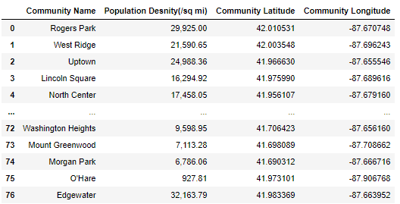
Community Area Dataset

Slide 7
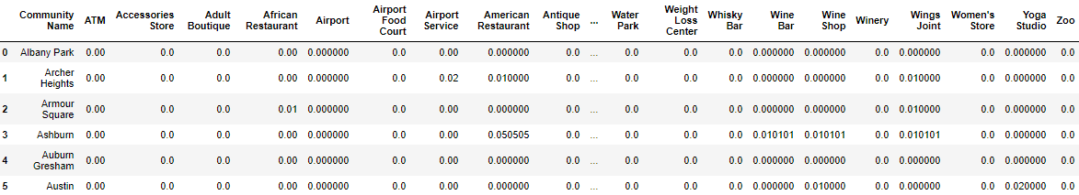
Foursquare Community Area Dataset
The Foursquare Dataset was retrieved. The Get Dummies Pandas command was then used to break down each venue category into a subsequent column. The data was then grouped by the Community Name column based on the mean value.

Slide 8
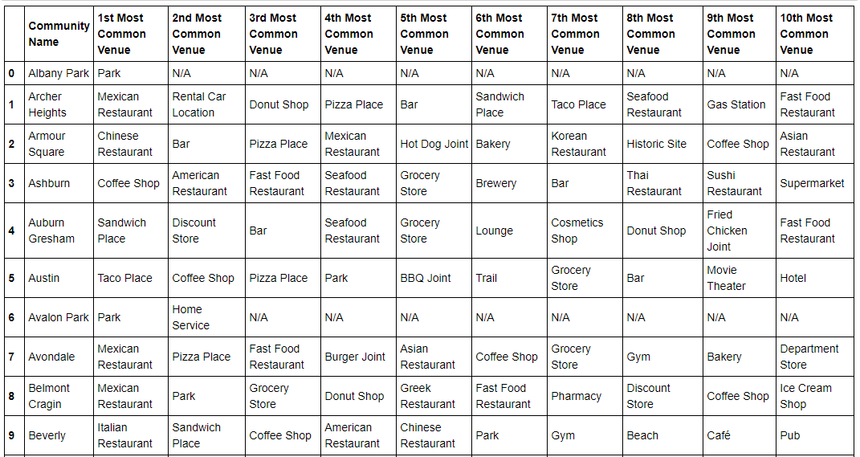
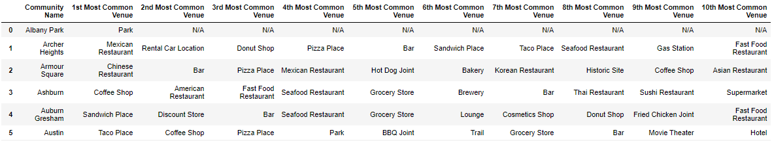
The Top 10 Most Common Venues for Each of the Community Areas

Slide 9
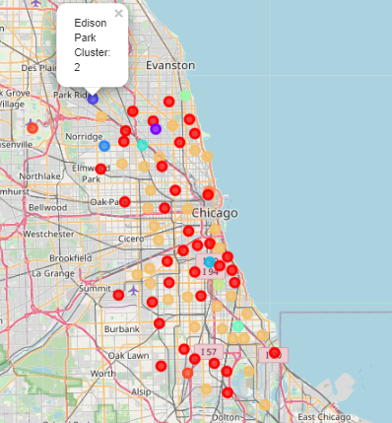
K-Means Clustering Based on Venue Categories

Slide 10
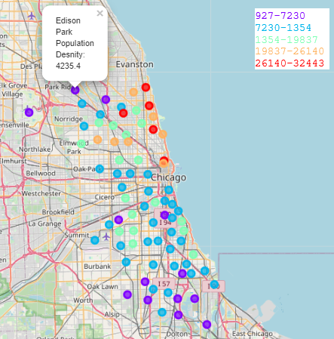
K-Means Segmenting Based on Population Density (5 Bins)

Slide 11
Discussion and Conclusions
The above maps and findings add an additional tool in the toolkit of entrepreneurs looking to scale up or set up new businesses in Chicago
The maps show an amount of heterogeneity between the 77 Community Areas of Chicago based on Venue Categories and Population Density.
Community areas that belong to the same cluster exhibit similarities between their venues which is an indicator of the customer groups that these areas attract.
The Population density map can be a good indicator of the expected foot traffic at a given area.
These maps should not be the sole tools that are used in deciding where to set up shop as other factors such as rent play an important role in the success of a new business.

